Slide 1
Advanced cryptography and application
Nguyen Dinh Thuc
University of Science, HCMC
ndthuc@fit.hcmus.edu.vn
http://sms.fit.hcmuns.edu.vn/i-learning/

Slide 2
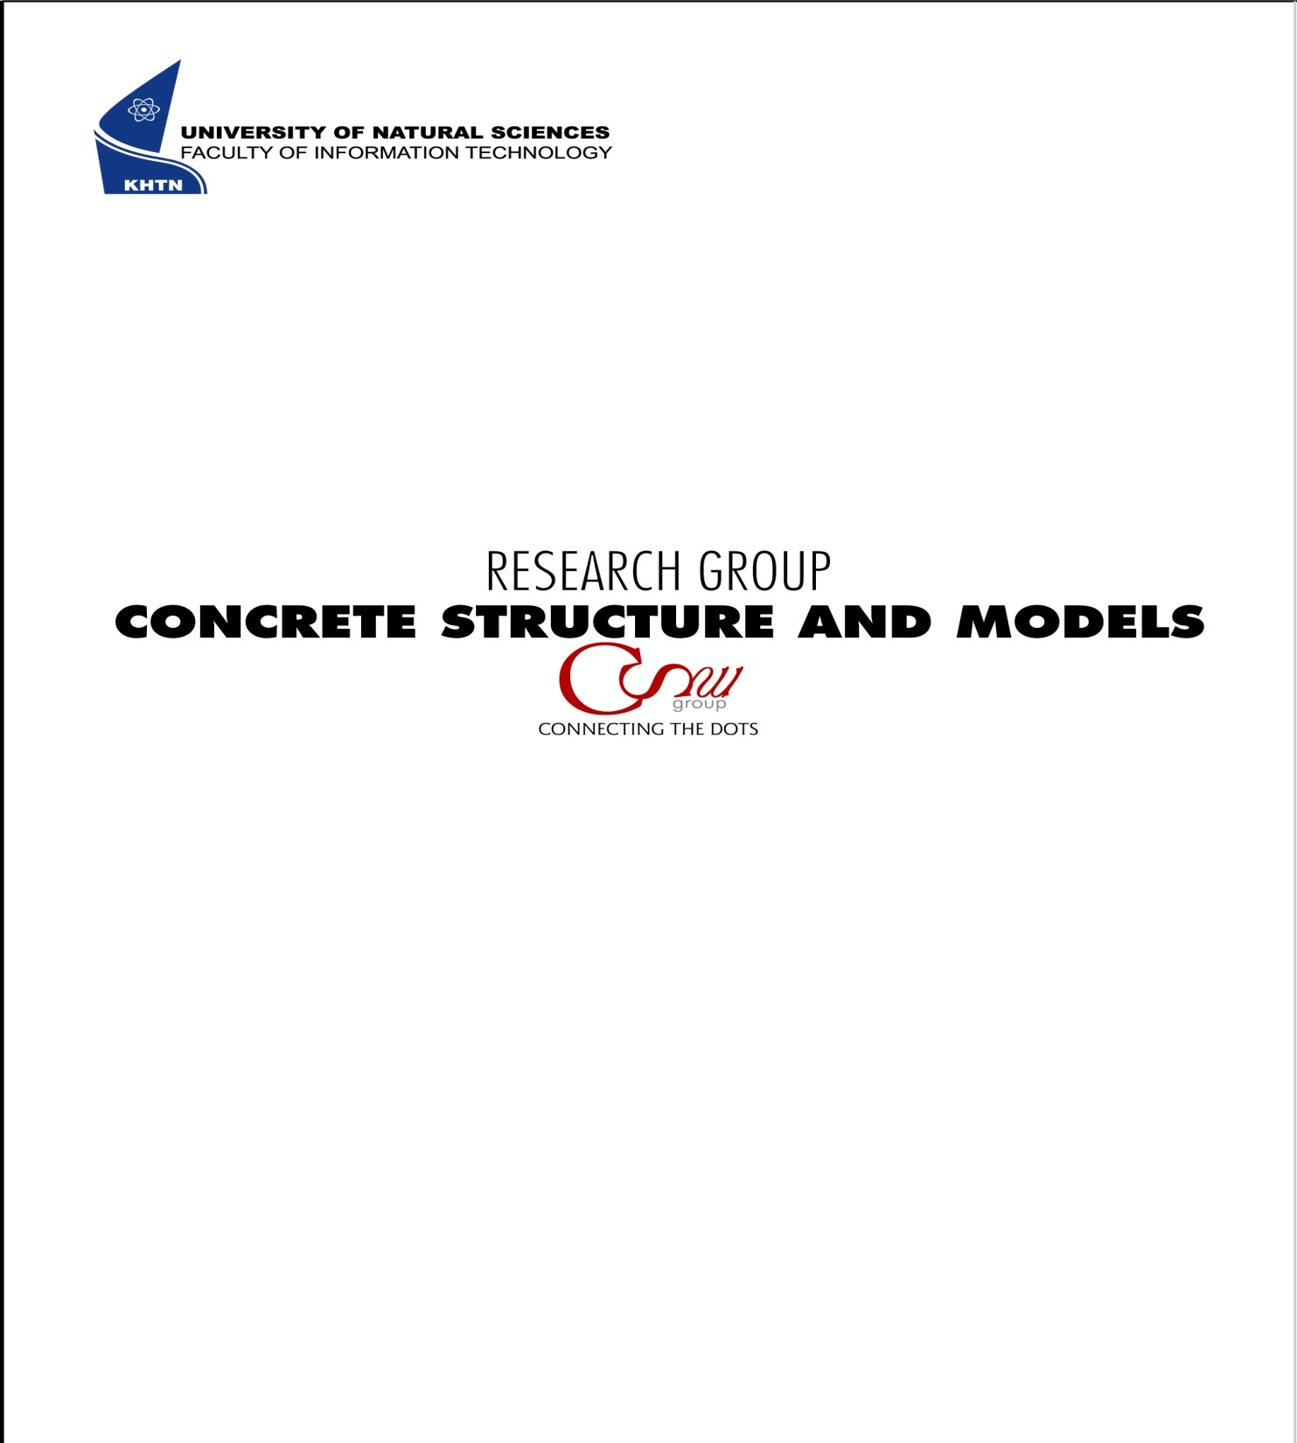
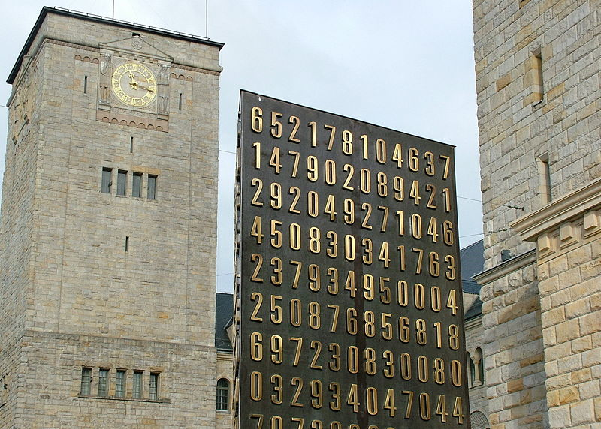

Slide 3
Course overview
This course covers:
Public key cryptanalysis (RSA and Elgamal)
Symmetric cryptography (Group based cryptosystems, Scalable cipher)
Applications

Slide 4
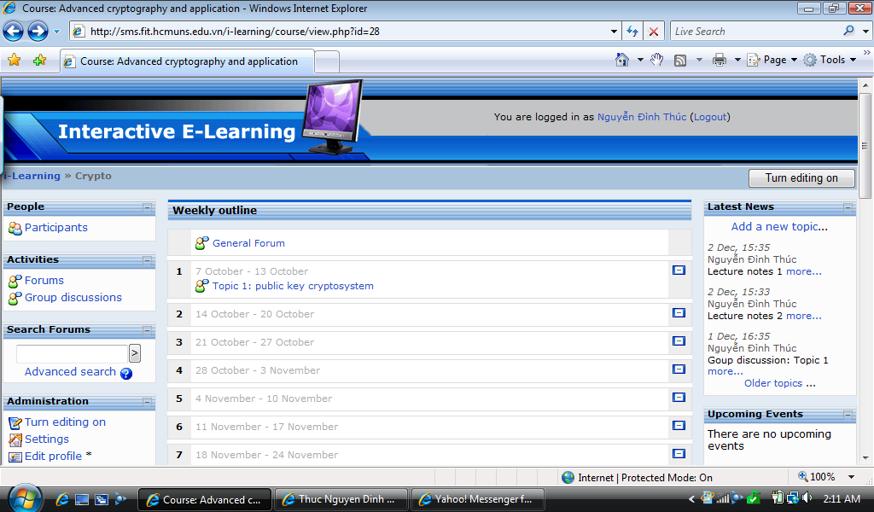
http://sms.fit.hcmuns.edu.vn/i-learning/
Login
Username: your name
Password: 111111 (default)

Slide 5
Assessment
Grades will be calculated on the basis of group discussion (50%) and project (50%)
Group discussion. There are 5 group discussion topics which students must participate to discuss via forum
(http://sms.fit.hcmuns.edu.vn/i-learning/)
Project. Students are expected to select a project and submit a project proposal at the end of December. At the end of January, 2010, students are expected to submit an 8-page conference style research paper on their works.

